Slide 1
Team 5 – DISease PROGNOSIS MODEL
Team Members #
Sravya kottisa
Chris bolger
Rajesh velamala

Slide 2
Our Project Goal
To design and train a machine learning model that can provide disease prognosis with high accuracy, leveraging the different symptoms.
The specific goals are to:
Develop a predictive model that combines data from multiple systems to improve disease prognosis
Achieve a target accuracy of 75% or higher
Create a scalable and interpretable model with APIs that can be integrated into clinical decision support systems

Slide 3
Data Collection
Source of data : UC Irvine Machine Learning Repository, Kaggle ( Readme file )
Type of Data : Health Symptoms and possible disease type
Total number of records # 32168 Records & 168 Columns
Preliminary Clean up
Null Handling
Imputation
Data Merging
Encoding
Removing duplicates
Removing Irrelevant data
Transformations
Data normalization

Slide 4
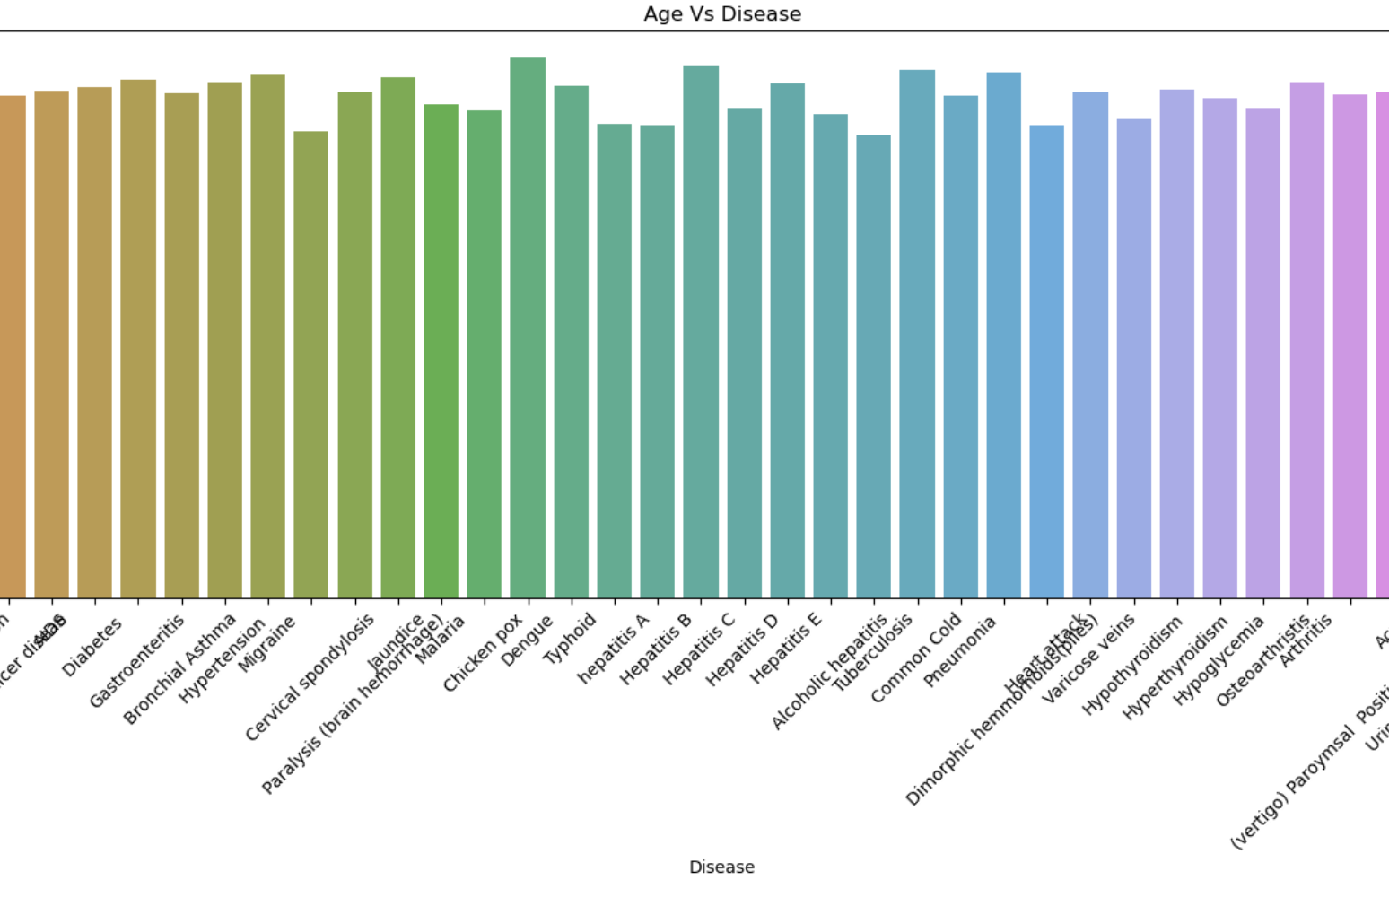
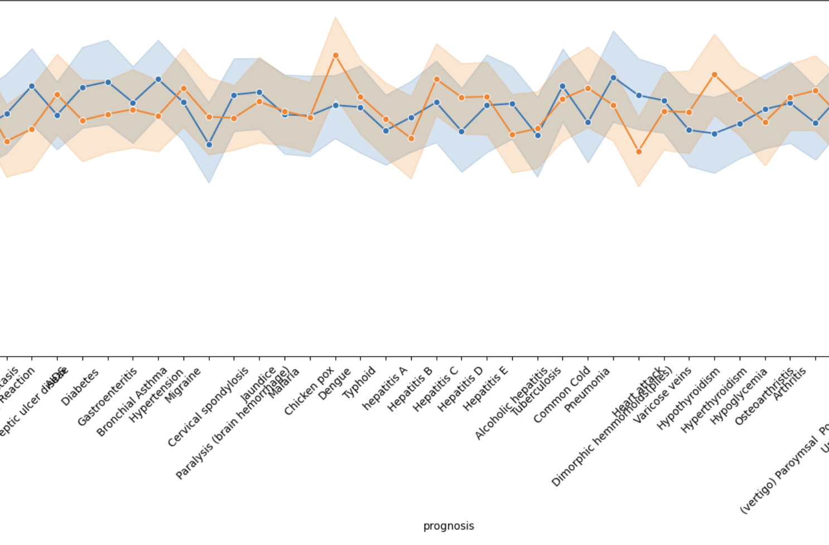
Data Analysis
Gender Vs Prognosis

Slide 5
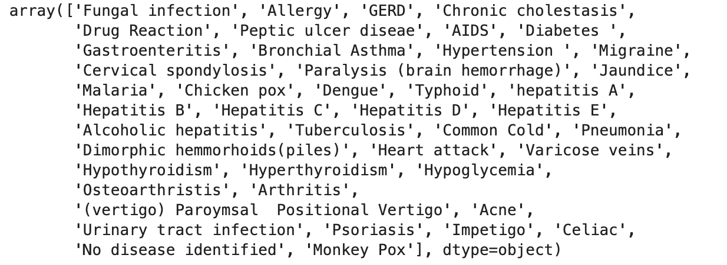
Data Processing
Total Features # 153
Symptoms # True/False ( 1/0)
Drop columns ( Null values)
Imputation of values, Drop Nulls
Final Clean Data set # 32168 Records
Target Value # Prognosis Type
Total Number of unique Prognosis # 44

Slide 6
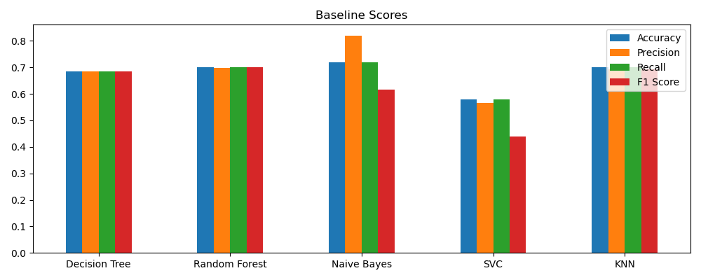
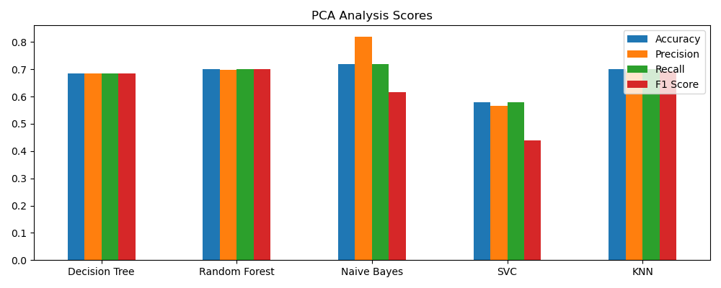
Model Development Journey

Slide 7
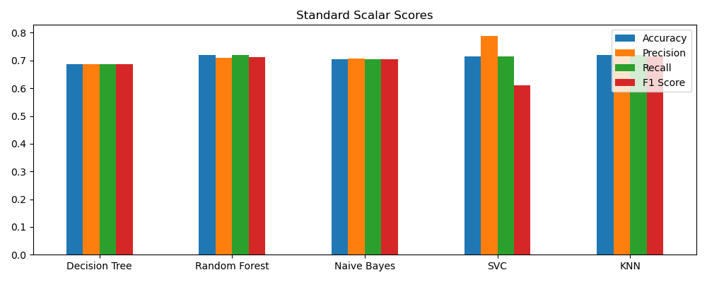
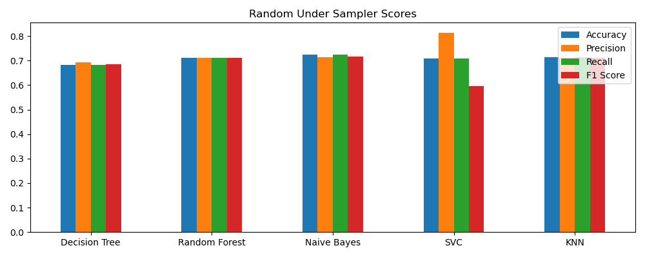
Model Development Journey

Slide 8
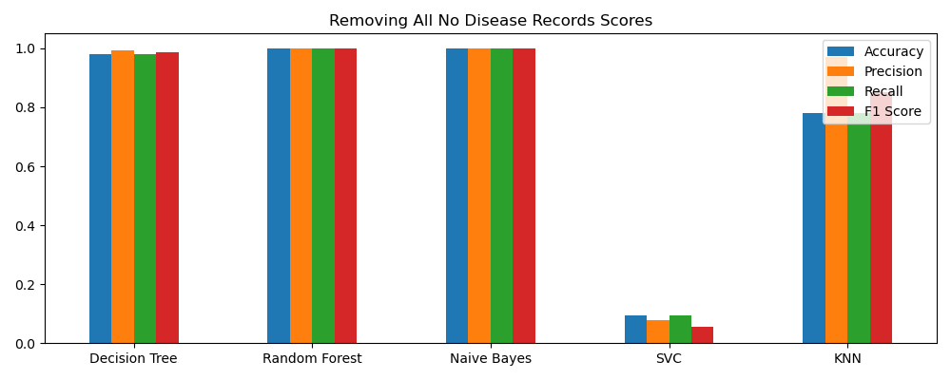
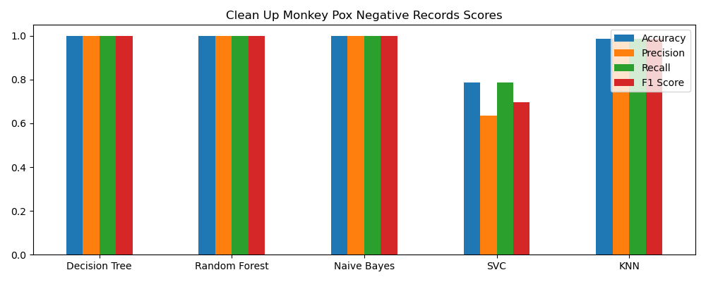
Model Development Journey

Slide 9
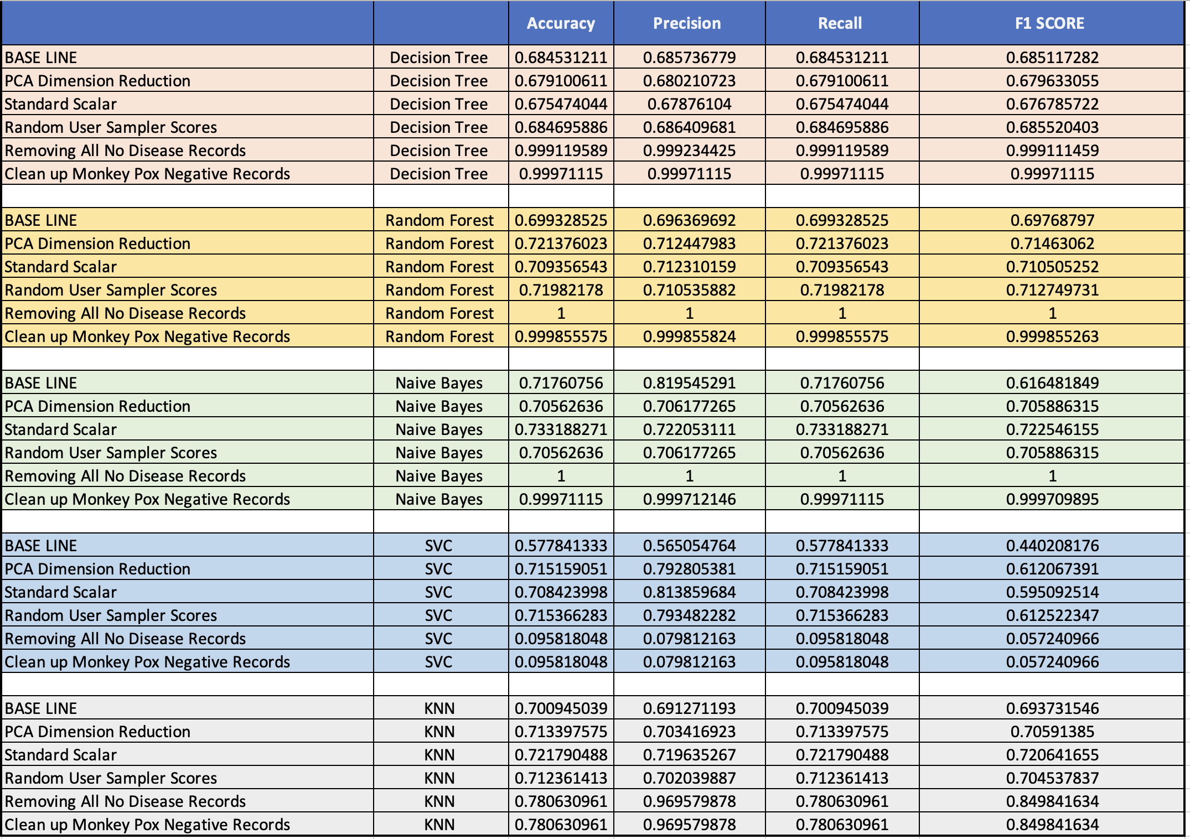
Model Training & Evaluation

Slide 10
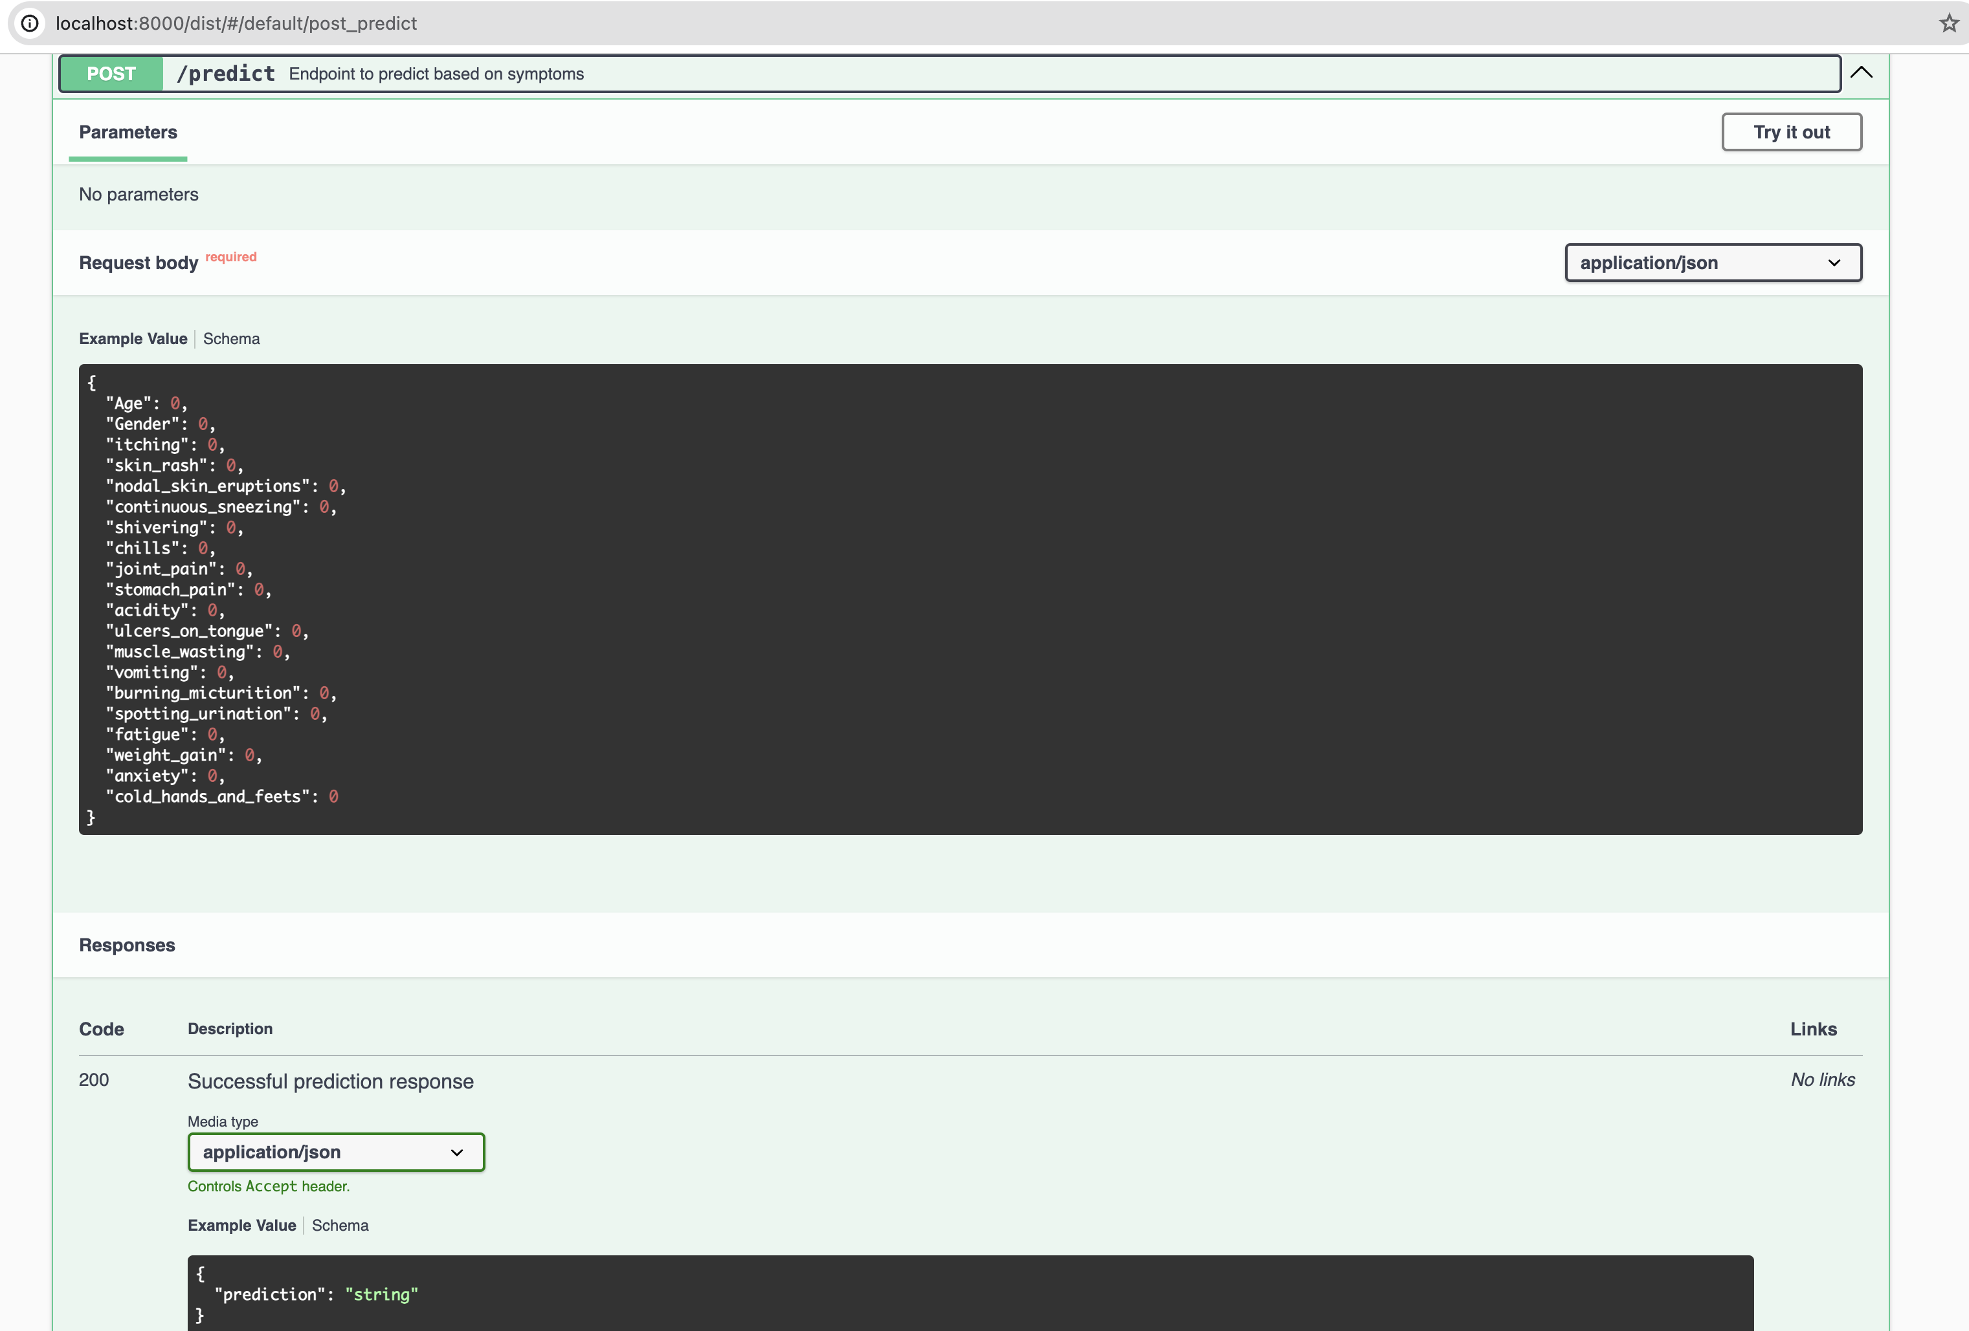
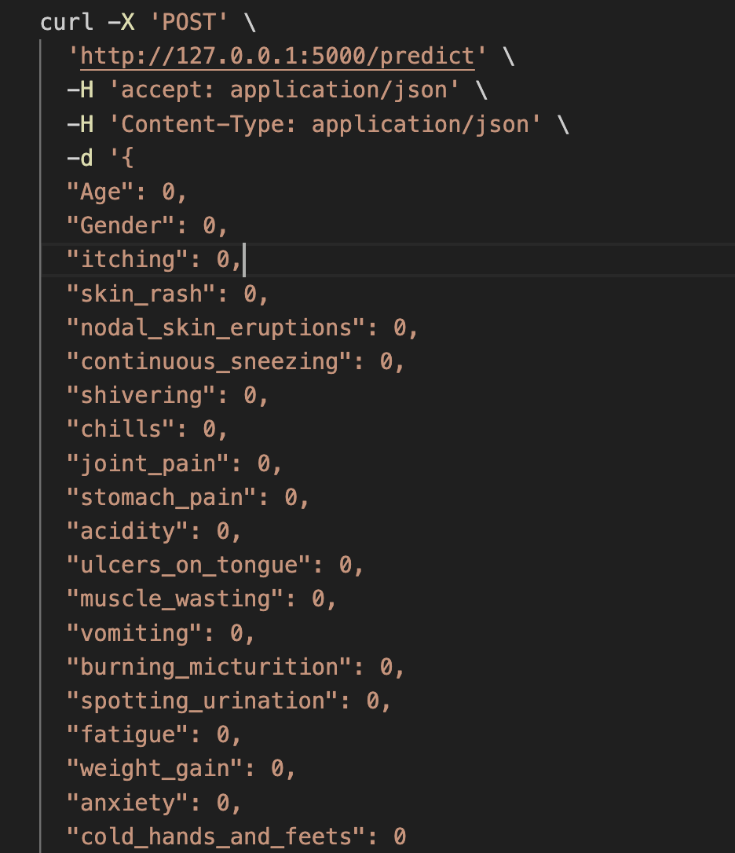
MODEL DEPLOYMENT
Naive Bayes model performance is better than the other models.
Model deployed and enabled via API for Prediction purposes
Pickle library to create the final pickle file to enable model via API.
Flask library to enable Model via rest API
Swagger UI to execute the model

Slide 11
Next steps
DEMO
Model Drift and Monitoring to train the model.
Model can self-learn to predict more disease types provided additional training data.
Extend the model to provide preliminary treatment guidance with additional feature training data
Rest APIs are provided for easy integration with external systems to use the prediction results.

Slide 12
Demo
THANK YOU

